Slide 1
An Introduction to Asynchronous Programming in Python
Marco Mak

Slide 2
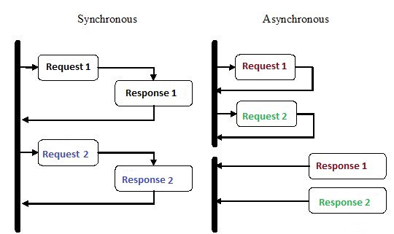
Asynchronous programming
Asynchronous programming is a type of parallel programming in which a unit of work is allowed to run separately from the primary application thread.
Benefits:
improved application performance
enhanced responsiveness

Slide 3
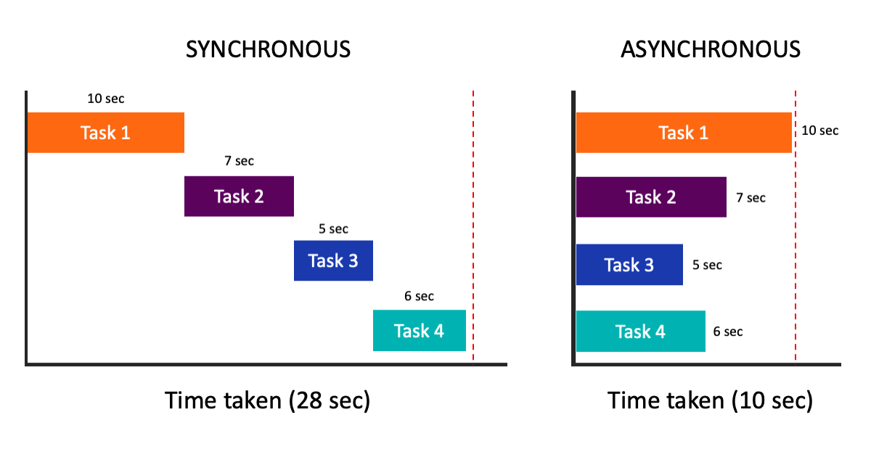
Asynchronous programming - Examples

Slide 4
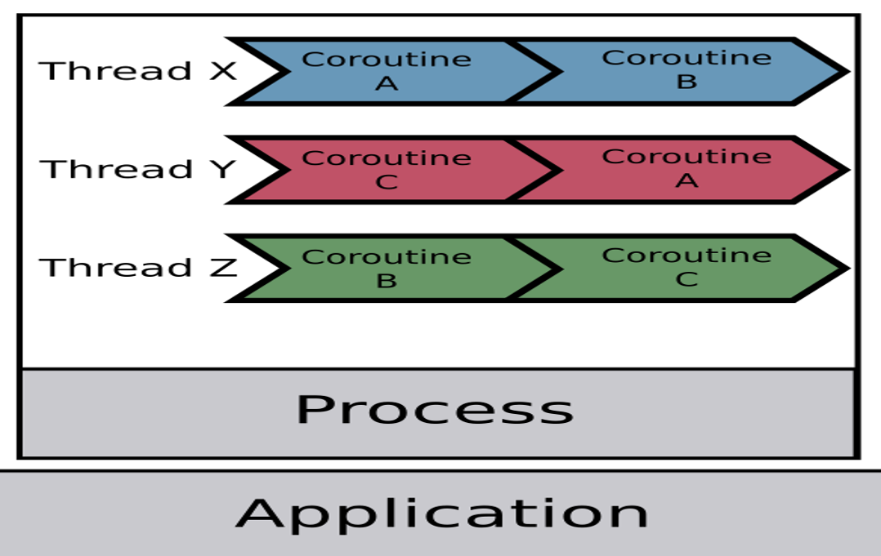
How Does Python Do Multiple Things At Once?
Process
Thread
Coroutine

Slide 5
Procecss vs Thread vs Coroutine
Multi-Processing usually refer to many processes execute in parallel. Process is smallest resource management unit, different process share different resource.
Multi-Threading usually refer to many threads execute concurrently, when there are idle cores, threads can use idle cores to run in parallel. Thread is smallest execution unit, a program needs at least one thread to run.
Coroutine usually refer to many routines execute concurrently.
Async programming is all about Coroutine , how to coordinate tasks
Async programming != Multi-Threading != Muilti-Processing

Slide 6
Concurrent vs Parallel
Concurrent: Coroutine A and Coroutine B are in same process, takes turns to own the thread, yield when waiting for resources or scheduled cpu time is used up.
Use case is dealing with I/O-intensive tasks.
Parallel: Thread A and Thread B are in different processes, execute at the same.
Use case is dealing with CPU(Data)-intensive tasks.

Slide 7
Asyncio
Python 3.4 introduced the asyncio library, and
Python 3.5 produced the async and await keywords to use it palatably
Problems resolved:
Asyncio offers a safer alternative to preemptive multitasking ( using thread), avoid bugs, race conditions, etc ( still will happen but not as frequent as multi-threading)
Asyncio offers a simple way to support many thousands of simultaneous socket connections ( WebSocket, MQTT for IoT)

Slide 8
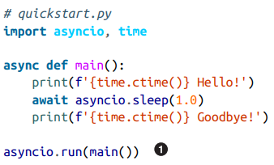

The “Hello World” of Asyncio
async.run function execute an async def function and the coroutines sleep()

Slide 9
The “Hello World” of Asyncio - Level 2
What is happening in async.run()
Starting the asyncio event loop
Calling async/await functions
Creating a task to be run on the loop
Waiting for multiple tasks to complete
Closing the loop after all concurrent tasks have completed

Slide 10

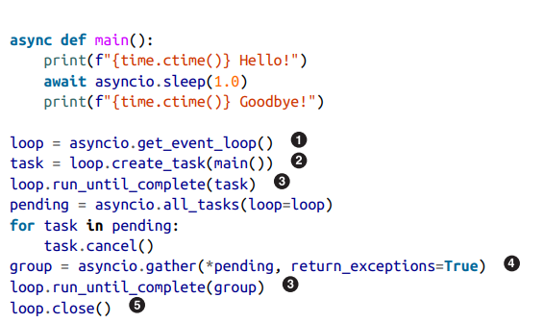
The “Hello World” of Asyncio - Level 2
What is happening in async.run()
Starting the asyncio event loop
Calling async/await functions
Creating a task to be run on the loop
Waiting for multiple tasks to complete
Closing the loop after all concurrent tasks have completed
gather the still-pending tasks, cancel them, and run again to make the pending task finish up

Slide 11
The basic executor interface
Assume we have a task is blocking IO execution and we cant change it to a async function, how should we handle it?
Blocking mean make the thread busy
Solution:
Put the blocking task into another thread

Slide 12
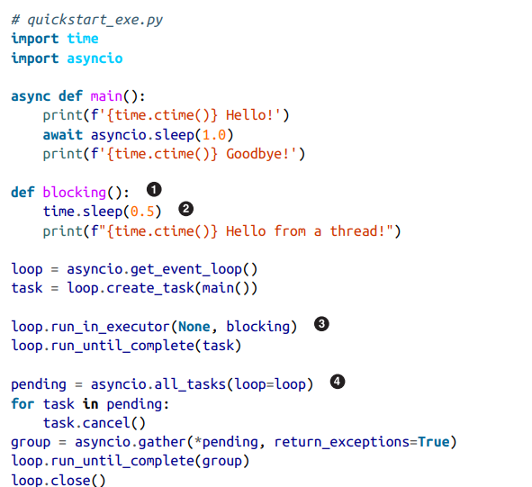
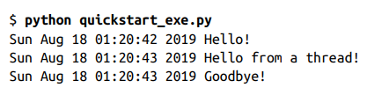
The basic executor interface
loop.run_in_executor put the the blocking task into other thread
None - default executor - ThreadPoolExecutor

Slide 13
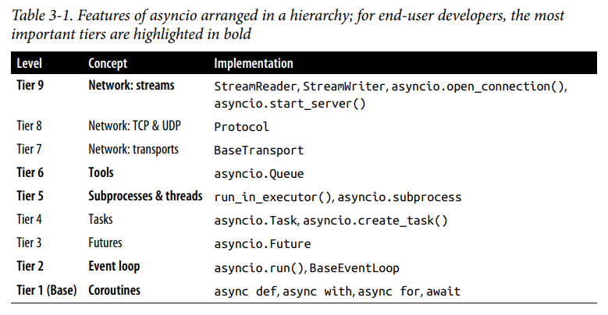
The Tower of Asyncio
A Future instance represents some sort of ongoing action that will return a result via notification on the event loop
A Task represents a coroutine running on the event loop
asyncio.Queue provide a thread safe implementation

Slide 14
Examples - Stress test
synchronous version
10 requests takes around 6s
one by one
import requests def do_requests(): resp = requests.get('https://example.com') print('example.com =>', resp.status_code) def main(): for _ in range(0, 10): do_requests() if __name__ == '__main__': main()
$ time python test.py example.com => 200 example.com => 200 example.com => 200 example.com => 200 example.com => 200 example.com => 200 example.com => 200 example.com => 200 example.com => 200 example.com => 200 python test.py 0.40s user 0.14s system 7% cpu 6.717 total

Slide 15
Examples - Stress test
import aiohttp import asyncio def do_requests(session): return session.get('https://example.com') async def main(): async with aiohttp.ClientSession() as session: tasks = [] for _ in range(0, 10): tasks.append(do_requests(session)) results = await asyncio.gather(*tasks) for r in results: print('example.com =>', r.status) if __name__ == '__main__': asyncio.run(main())
asynchronous version
10 requests takes around 1s
10 requests concurrently
$ time python test_async.py example.com => 200 example.com => 200 example.com => 200 example.com => 200 example.com => 200 example.com => 200 example.com => 200 example.com => 200 example.com => 200 example.com => 200 python test_async.py 0.30s user 0.13s system 18% cpu 0.971 total

Slide 16
The Tower of Asyncio
A Future instance represents some sort of ongoing action that will return a result via notification on the event loop
A Task represents a coroutine running on the event loop
asyncio.Queue provide a thread safe implementation

Slide 17
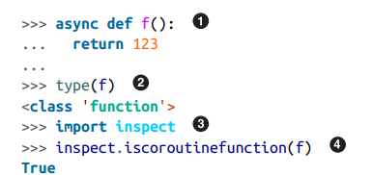
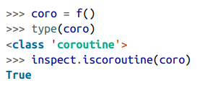
Coroutines vs Async Function
Async function are functions, not coroutines
A coroutine is an object that encapsulates the ability to resume an underlying function that has been suspended before completion
Similar to Generator (yield)

Slide 18
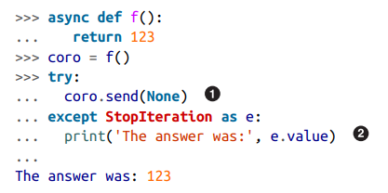
Coroutine - Deep Dive
event loop send None to coroutine
loop.create_task(coro) or await coro will .send(None) behind the scenes
when coroutine return, StopIteration raised
send means start, StopIteration means end

Slide 19
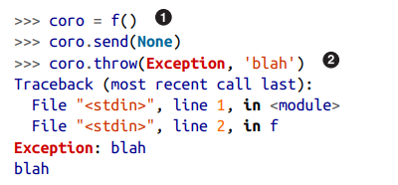
Coroutine - Deep Dive
How coroutines can be fed exceptions
task.cancel() will let the event loop internally use coro.throw() to raise asyncio.CancelledError

Slide 20
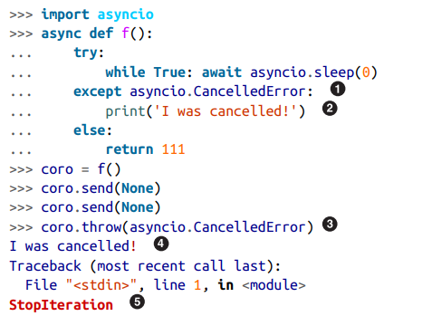
Coroutine - Deep Dive
Handling task cancelling
The coroutine exist normally as StopIteration Exception is raised

Slide 21
Event Loop - Deep Dive
Recommend (python 3.8) asyncio.get_running_loop() callable from inside the context of a coroutine
Discouraged asyncio.get_event_loop() callable from anywhere
Handles all of the switching between coroutine
Catching the StopIteration Exception

Slide 22
Tasks - Deep Dive
Event loops use cooperative scheduling:
an event loop runs one Task at a time. While a Task awaits for the completion of a Future, the event loop runs other Tasks, callbacks, or performs IO operations
coro - async function type
coro() - coroutine type
task - task type
import asyncio async def coro(): print('hello') await asyncio.sleep(1) print('world') loop = asyncio.get_event_loop() task = loop.create_task(coro()) loop.run_until_complete(task)

Slide 23

Futures - Deep Dive
Future Class is a superclass of Task
The Future class represents a state of something that is interacting with a loop
The state will change overtime from pending to completed
• Have a “result” value set (use .set_result(value) to set it and .result() to obtain it)
• Be cancelled with .cancel() (and check for cancellation with .cancelled())
• Have additional callback functions added that will be run when the future completes

Slide 24
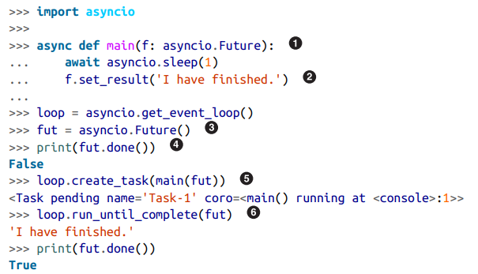

Futures - Deep Dive
The Future instance is returned by running a function on an exectuor
.done() check the status
.result() check the result
*Task cannot invoke set result operation

Slide 25
Futures - Deep Dive
The Future instance is returned by running a function on an exectuor
.done() check the status
.result() check the result
*Task cannot invoke set result operation

Slide 26
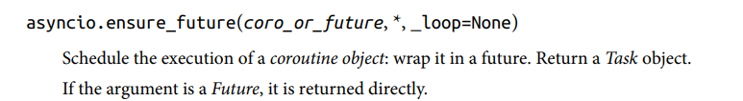
Confusion in Task and Future
Two ways to create Tasks:
asyncio.create_task()
asyncio.ensure_future()
Why two similar function?
ensure_future() is intended to be used by framework authors to provide APIs to end-user developers that can handle both kinds of parameters

Slide 27
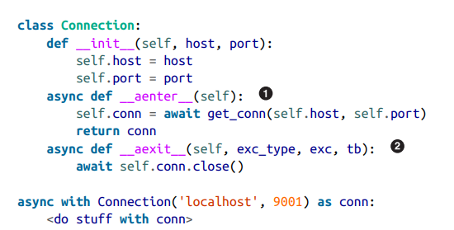
Async Context Managers: async with
Why async context manager:
realize that the operation of a context manager is driven by method calls
What should be the coroutine function
This is How aiohttp implemented

Slide 28
Lots of topic with Asyncio
async for
async generators
async comprehensions
stop task gracefully
Signal
Multi-threading and multi processing with asyncio

